Slide 1
Topic 5. Model Selection and Regularization

Slide 2
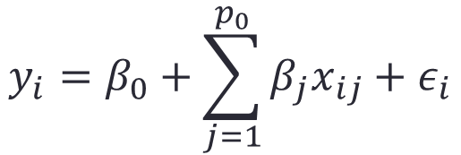
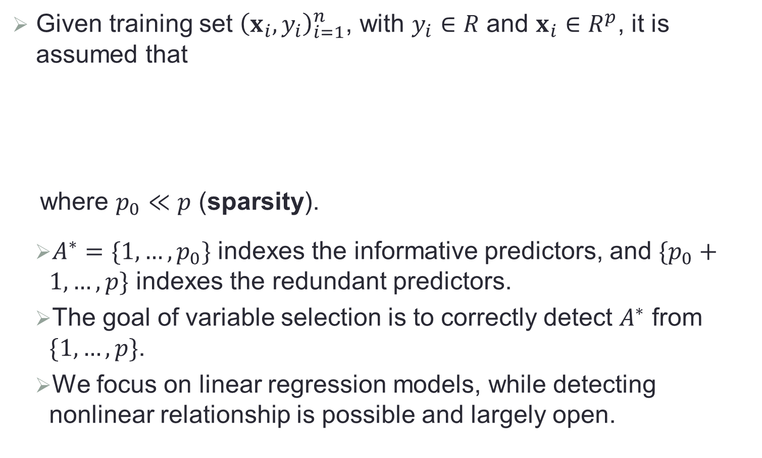
Sparse Regression
Given training set ${\left(x_{i},y_{i}\right)}_{i=1}^{n}$, with $y_{i}∈R$ and $x_{i}∈R^{p}$, it is assumed that
where $p_{0}≪p$ (sparsity).
$A^{∗}=\{1,…,p_{0}\}$ indexes the informative predictors, and $\{p_{0}+1,…,p\}$ indexes the redundant predictors.
The goal of variable selection is to correctly detect $A^{∗}$ from $\{1,…,p\}$.
We focus on linear regression models, while detecting nonlinear relationship is possible and largely open.
$$y_{i}=β_{0}+\sum_{j=1}^{p_{0}}{β_{j}x_{ij}}+ε_{i}$$

Slide 3
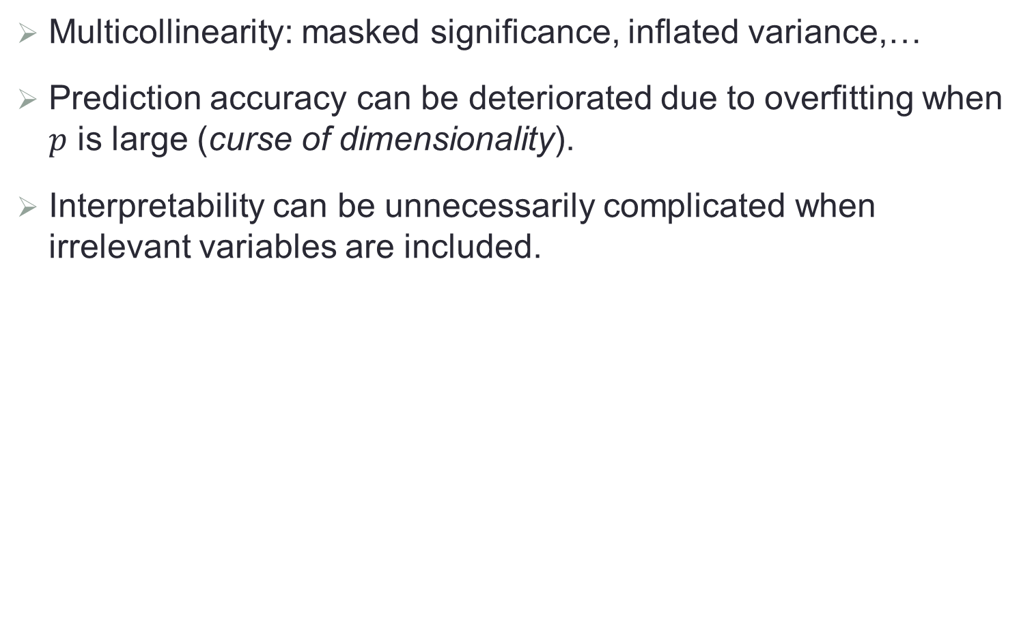
Why Do We Care?
Multicollinearity: masked significance, inflated variance,…
Prediction accuracy can be deteriorated due to overfitting when $p$ is large (curse of dimensionality).
Interpretability can be unnecessarily complicated when irrelevant variables are included.

Slide 4
Popular Techniques
Best subset selection
Various information criteria, cross validation
Sequential variable selection
Forward/backward selection
Shrinkage methods
Lasso and its variants
Dimension reduction
Principal component analysis, sufficient dimension reduction

Slide 5
Best Subset Selection
Popular selection criteria
Validation set
Cross validation
“Estimate” test error by making an adjustment to the training error to account for overfitting

Slide 6
Adjustment to Training Error

Slide 7
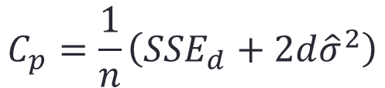
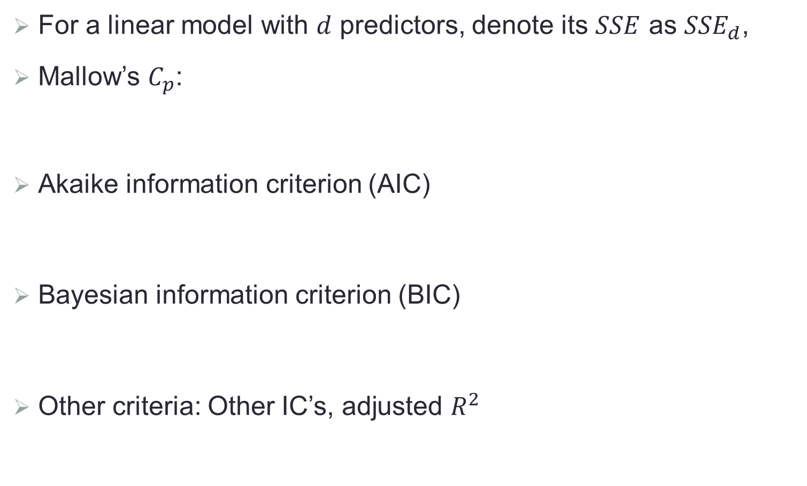
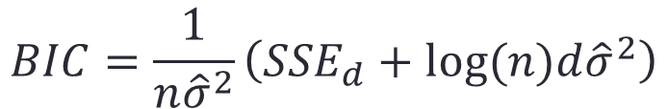
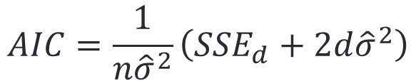
Model Selection Criteria
For a linear model with $d$ predictors, denote its $SSE$ as ${SSE}_{d}$,
Mallow’s $C_{p}$:
Akaike information criterion (AIC)
Bayesian information criterion (BIC)
Other criteria: Other IC’s, adjusted $R^{2}$
$$C_{p}=\frac{1}{n}\left({SSE}_{d}+2d{\hat{σ}}^{2}\right)$$
$$AIC=\frac{1}{n{\hat{σ}}^{2}}\left({SSE}_{d}+2d{\hat{σ}}^{2}\right)$$
$$BIC=\frac{1}{n{\hat{σ}}^{2}}\left({SSE}_{d}+log⁡(n)d{\hat{σ}}^{2}\right)$$

Slide 8
An Illustrative Example

Slide 9
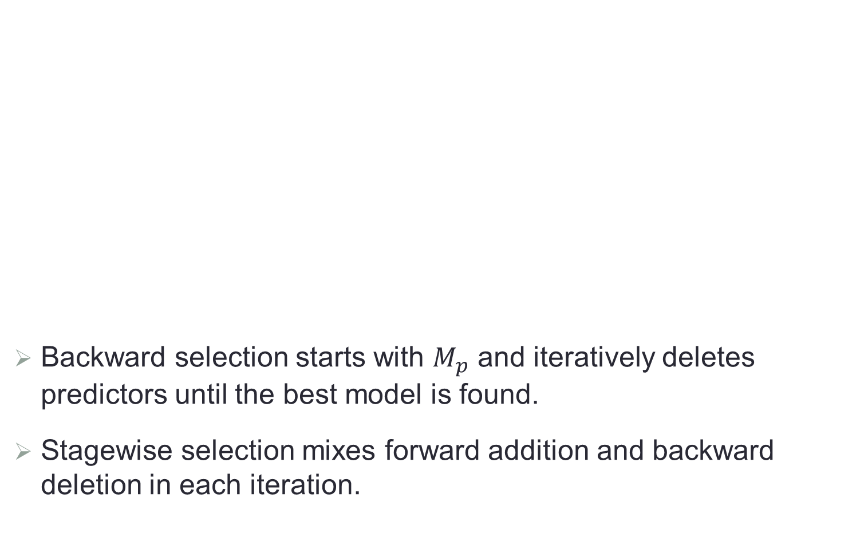
Forward/Backward Selection
Backward selection starts with $M_{p}$ and iteratively deletes predictors until the best model is found.
Stagewise selection mixes forward addition and backward deletion in each iteration.

Slide 10
Some Remarks
Forward/backward selection is computationally more efficient than subset selection.
It has no guarantee of the best possible model.
It usually performs well in practice.
Forward versus backward selection

Slide 11
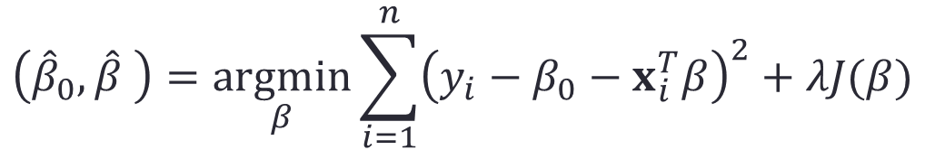
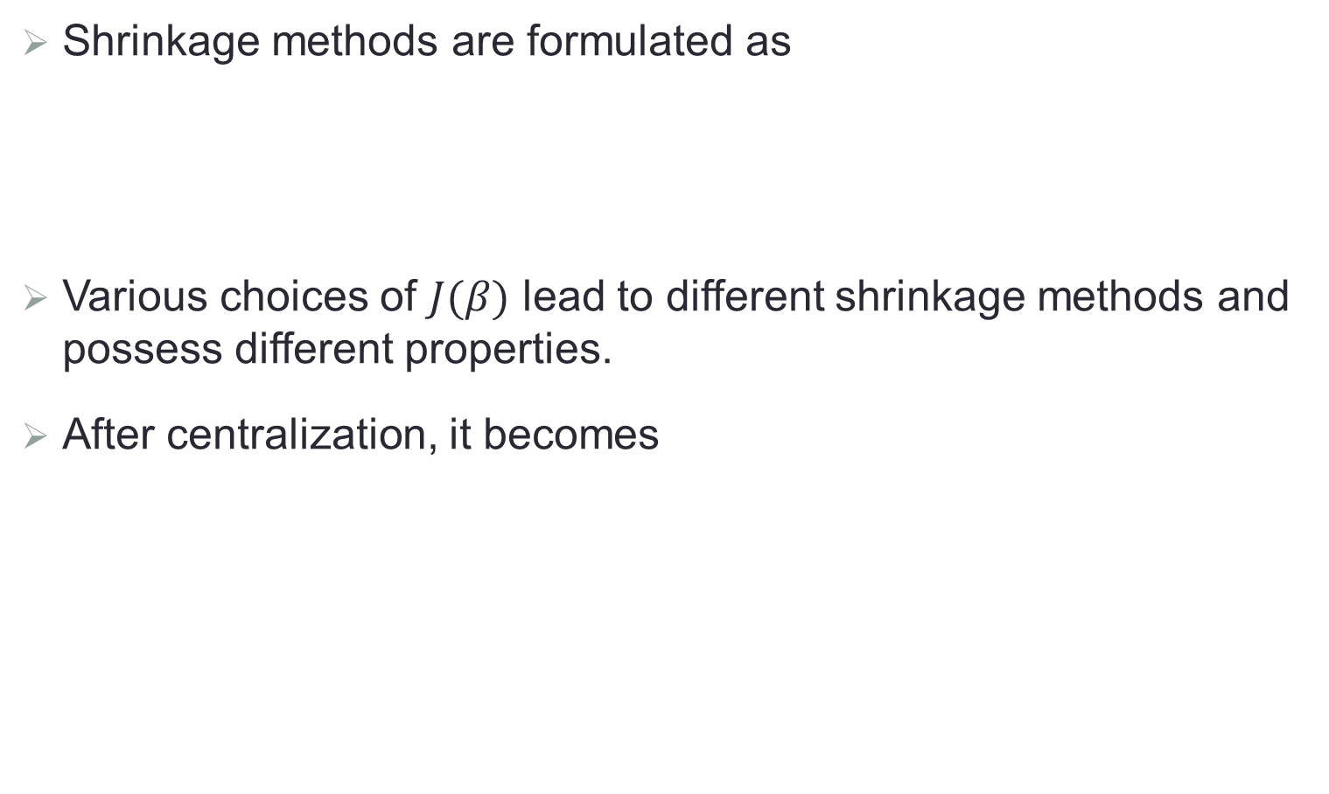
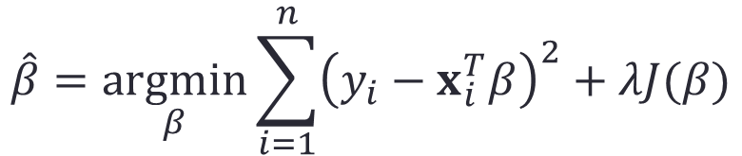
Shrinkage Methods
Shrinkage methods are formulated as
Various choices of $J(β)$ lead to different shrinkage methods and possess different properties.
After centralization, it becomes
$$\left({\hat{β}}_{0},\hat{β} \right)=\underset{β}{argmin}{\sum_{i=1}^{n}{{\left(y_{i}−β_{0}−x_{i}^{T}β\right)}^{2}}+λJ(β)}$$
$$\hat{β}=\underset{β}{argmin}{\sum_{i=1}^{n}{{\left(y_{i}−x_{i}^{T}β\right)}^{2}}+λJ(β)}$$

Slide 12
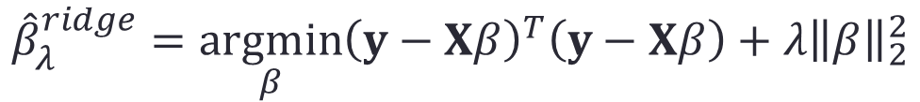
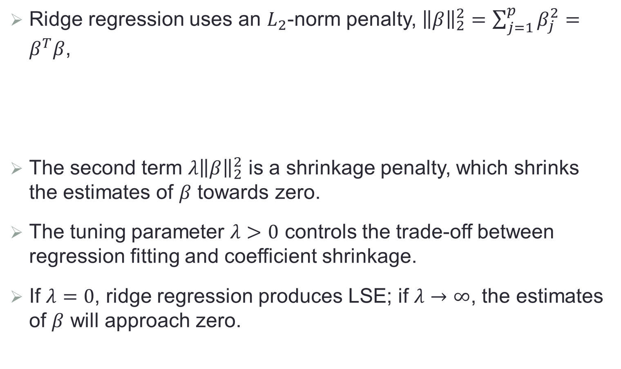
Ridge Regression
Ridge regression uses an $L_{2}$-norm penalty, ${\left\|β\right\|}_{2}^{2}=\sum_{j=1}^{p}{β_{j}^{2}}=β^{T}β$,
The second term $λ{\left\|β\right\|}_{2}^{2}$ is a shrinkage penalty, which shrinks the estimates of $β$ towards zero.
The tuning parameter $λ>0$ controls the trade-off between regression fitting and coefficient shrinkage.
If $λ=0$, ridge regression produces LSE; if $λ→∞$, the estimates of $β$ will approach zero.
$${\hat{β}}_{λ}^{ridge}=\underset{β}{argmin}{{\left(y−Xβ\right)}^{T}\left(y−Xβ\right)}+λ{\left\|β\right\|}_{2}^{2}$$

Slide 13
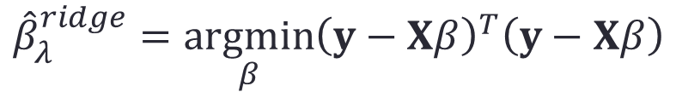


Ridge Regression (Cont.)
Solution of the ridge regression is
An equivalent formulation
$${\hat{β}}_{λ}^{ridge}={\left(X^{T}X+λI_{p}\right)}^{−1}X^{T}y$$
$${\hat{β}}_{λ}^{ridge}=\underset{β}{argmin}{{\left(y−Xβ\right)}^{T}\left(y−Xβ\right)}$$
subject to
$${\left\|β\right\|}^{2}≤s$$

Slide 14
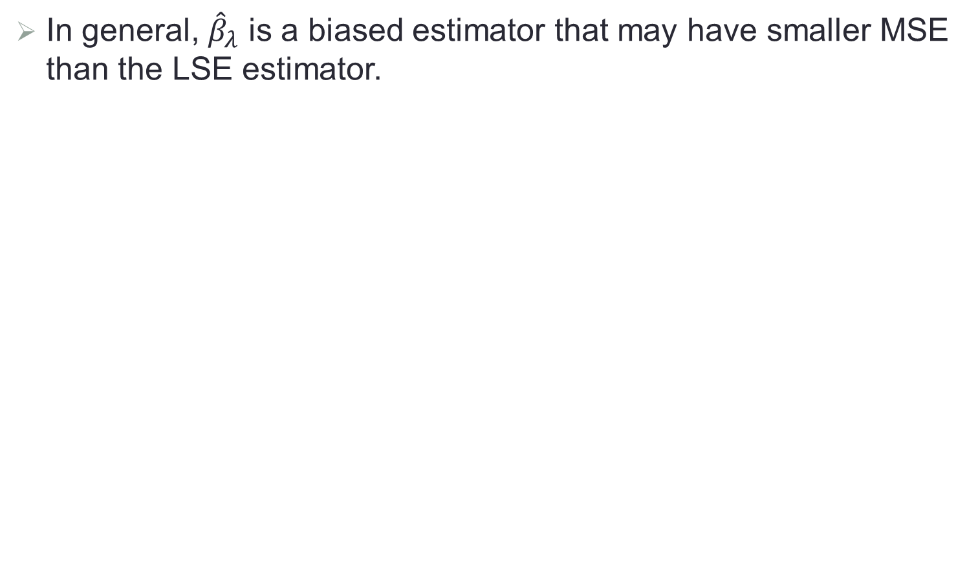
Example
In general, ${\hat{β}}_{λ}$ is a biased estimator that may have smaller MSE than the LSE estimator.

Slide 15
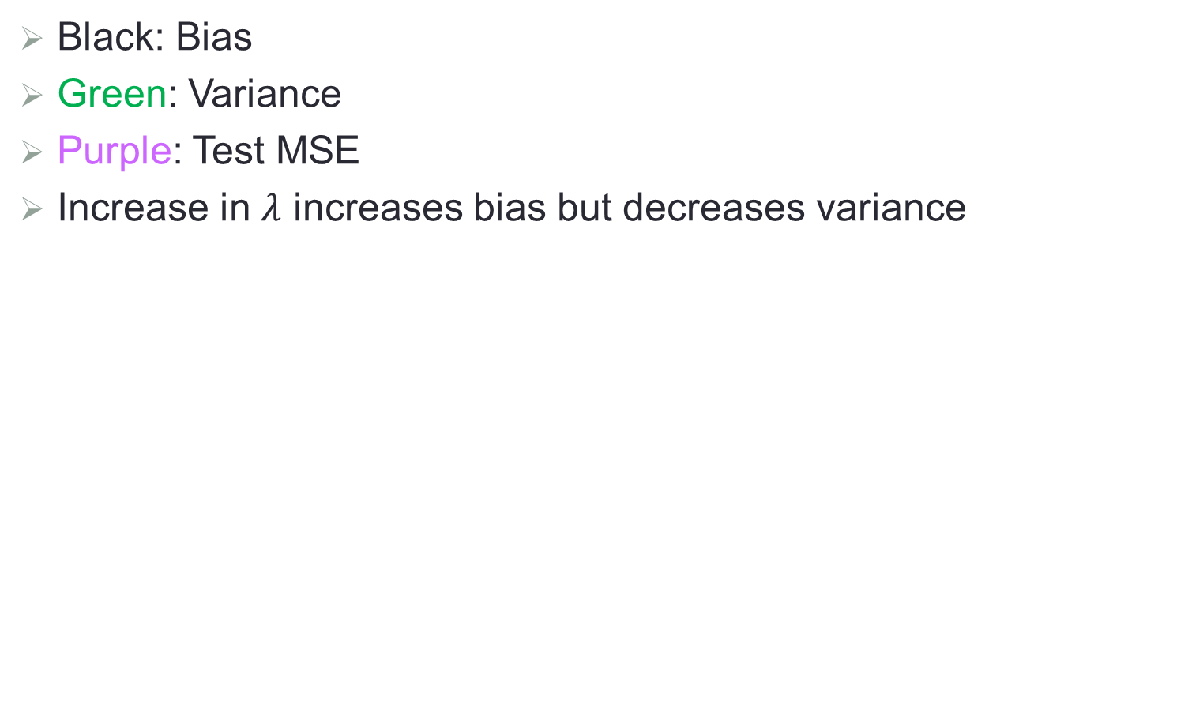
An Example (Cont.)
Black: Bias
Green: Variance
Purple: Test MSE
Increase in $λ$ increases bias but decreases variance

Slide 16
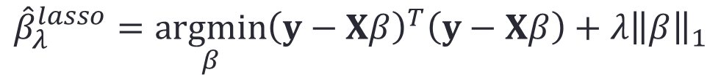
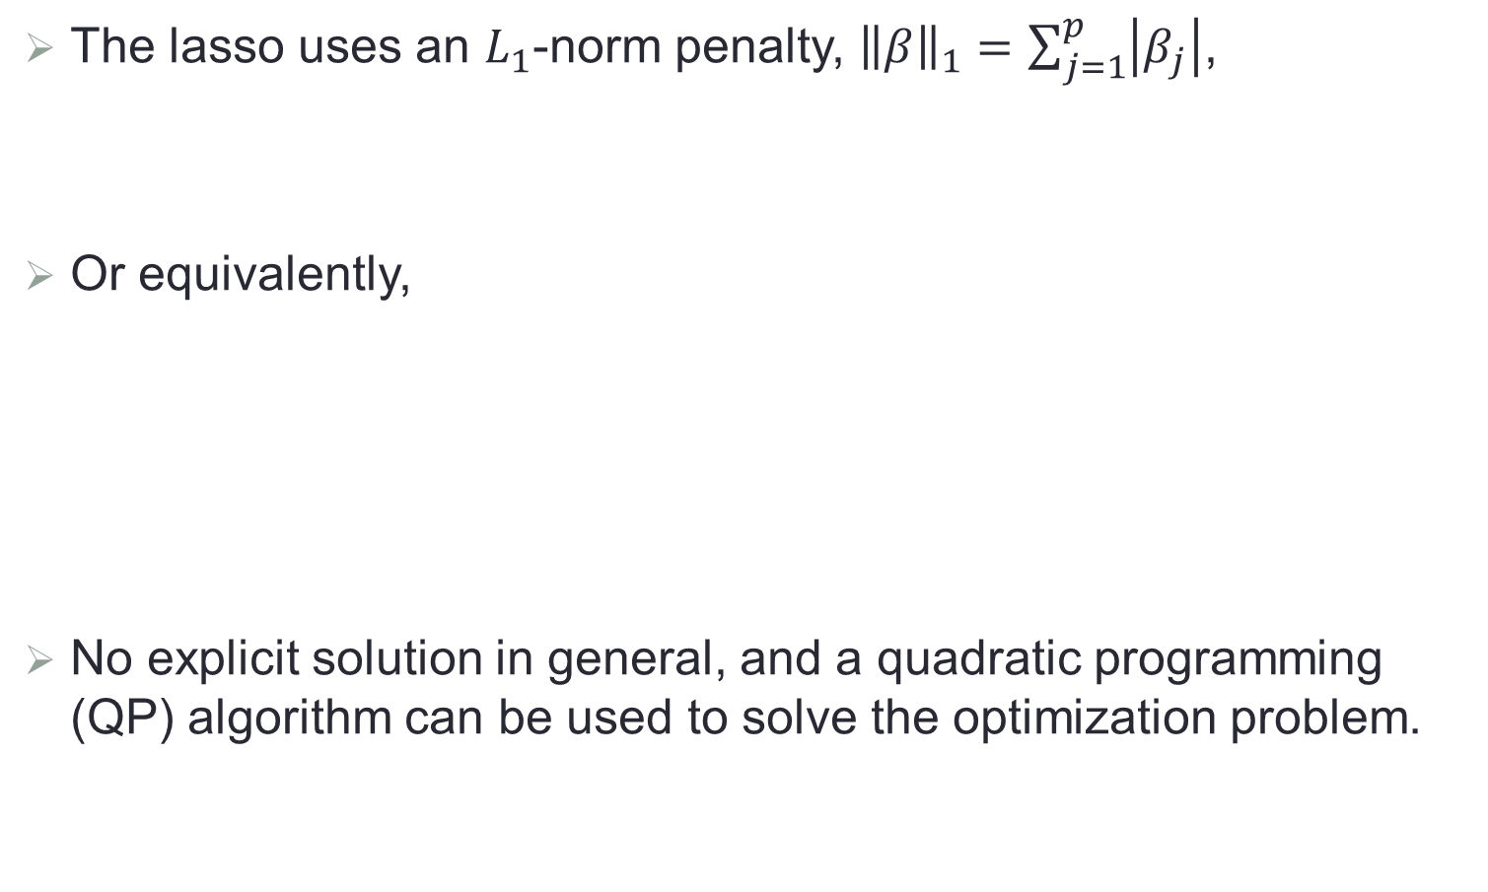

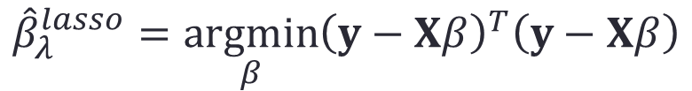
LASSO
The lasso uses an $L_{1}$-norm penalty, ${\left\|β\right\|}_{1}=\sum_{j=1}^{p}{\left|β_{j}\right|}$,
Or equivalently,
No explicit solution in general, and a quadratic programming (QP) algorithm can be used to solve the optimization problem.
$${\hat{β}}_{λ}^{lasso}=\underset{β}{argmin}{{\left(y−Xβ\right)}^{T}\left(y−Xβ\right)}+λ{\left\|β\right\|}_{1}$$
$${\hat{β}}_{λ}^{lasso}=\underset{β}{argmin}{{\left(y−Xβ\right)}^{T}\left(y−Xβ\right)}$$
subject to
$${\left\|β\right\|}_{1}≤s$$

Slide 17


Sparse Solution
Some coefficients of the lasso solution will become exactly zero, and thus it does some kind of continuous variable selection.
$\left|β_{1}\right|+\left|β_{2}\right|≤s$
$β_{1}^{2}+β_{2}^{2}≤s$

Slide 18
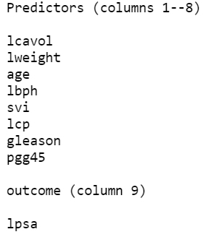
Example: Prostate Cancer
Data
Clinical measures
Level of prostate-specific antigen

Slide 19
Example: Prostate Cancer (Cont.)
Left: ridge regression; Right: lasso

Slide 20
Ridge vs. Lasso
Both lasso and ridge regression will shrink estimated coefficients while introducing some bias.
The lasso produces simpler and more interpretable models that involve only a subset of predictors.
It is unclear which one leads to better prediction accuracy in general though.

Slide 21
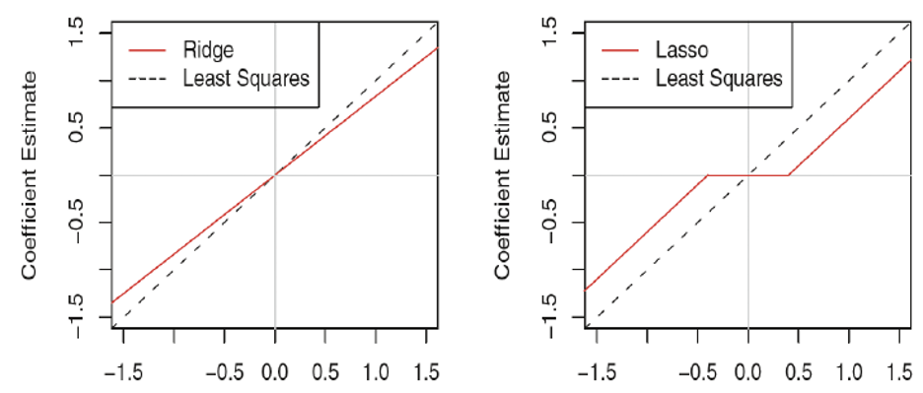
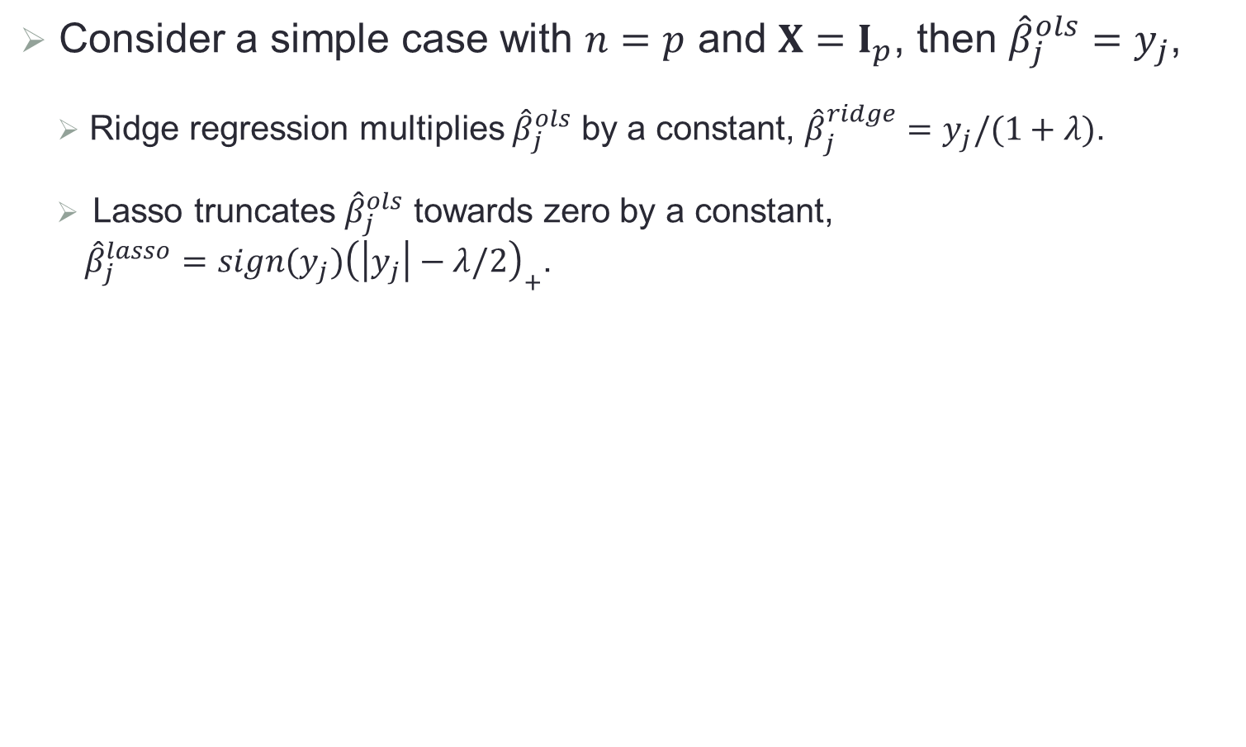
A Special Simple Case
Consider a simple case with $n=p$ and $X=I_{p}$, then ${\hat{β}}_{j}^{ols}=y_{j}$,
Ridge regression multiplies ${\hat{β}}_{j}^{ols}$ by a constant, ${\hat{β}}_{j}^{ridge}=y_{j}/(1+λ)$.
Lasso truncates ${\hat{β}}_{j}^{ols}$ towards zero by a constant,
${\hat{β}}_{j}^{lasso}=sign(y_{j}){\left(\left|y_{j}\right|−λ/2\right)}_{+}$.

Slide 22
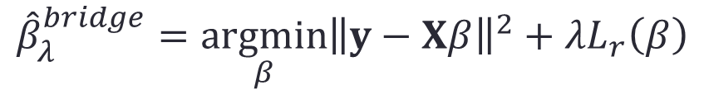
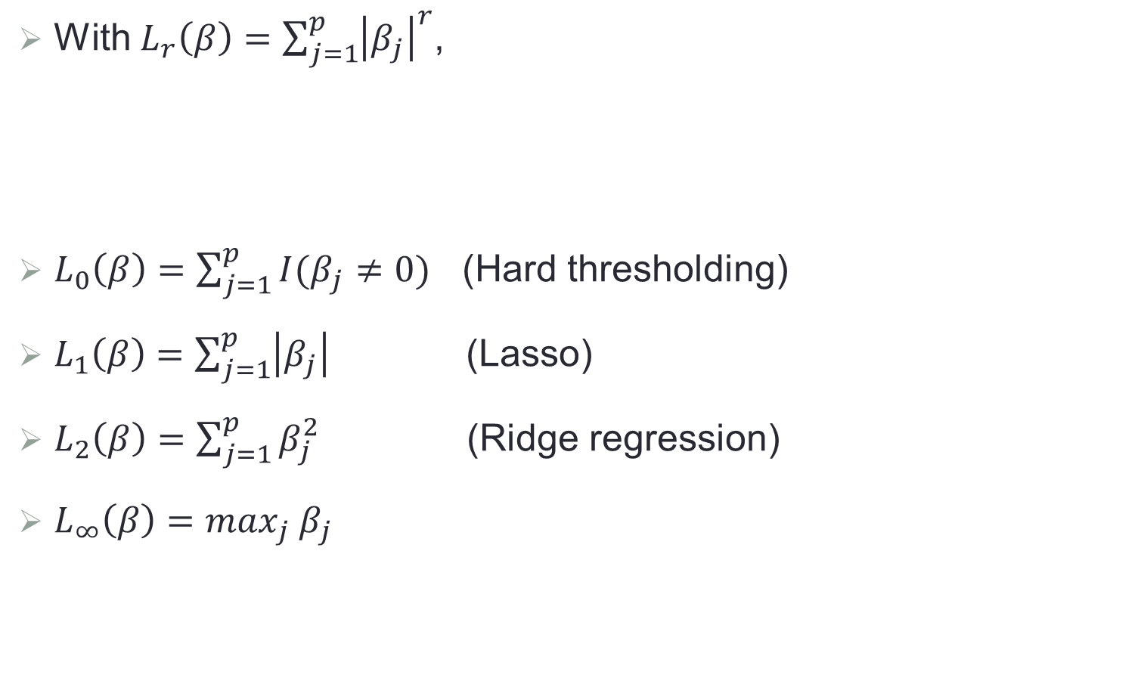
Bridge Estimators
With $L_{r}\left(β\right)=\sum_{j=1}^{p}{{\left|β_{j}\right|}^{r}}$,
$L_{0}\left(β\right)=\sum_{j=1}^{p}{I(β_{j}≠0)}$ (Hard thresholding)
$L_{1}\left(β\right)=\sum_{j=1}^{p}{\left|β_{j}\right|}$ (Lasso)
$L_{2}\left(β\right)=\sum_{j=1}^{p}{β_{j}^{2}}$ (Ridge regression)
$L_{∞}\left(β\right)=\max_{j} β_{j}$
$${\hat{β}}_{λ}^{bridge}=\underset{β}{argmin}{{\left\|y−Xβ\right\|}^{2}}+λL_{r}\left(β\right)$$

Slide 23
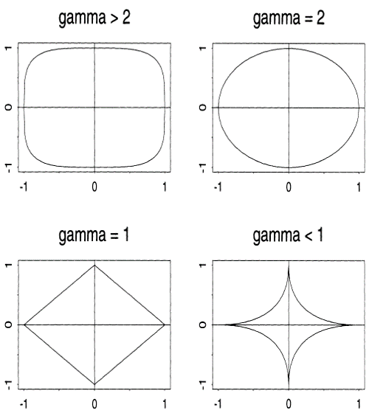




Constrained Areas of Bridge Regressions
$$r>2$$
$$r=2$$
$$r=1$$
$$r<1$$

Slide 24
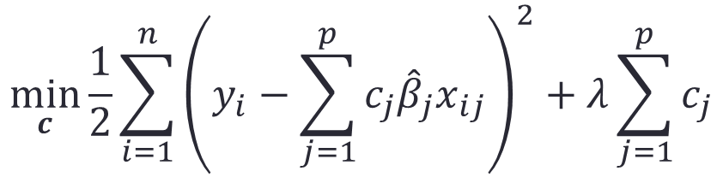
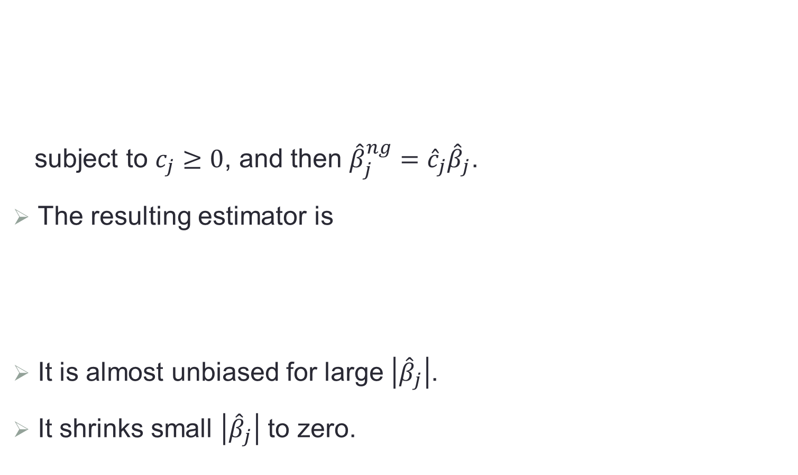
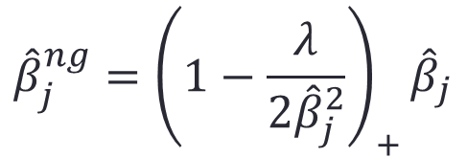
Nonnegative Garrote
subject to $c_{j}≥0$, and then ${\hat{β}}_{j}^{ng}={\hat{c}}_{j}{\hat{β}}_{j}$.
The resulting estimator is
It is almost unbiased for large $\left|{\hat{β}}_{j}\right|$.
It shrinks small $\left|{\hat{β}}_{j}\right|$ to zero.
$$\min_{c}{\frac{1}{2}\sum_{i=1}^{n}{{\left(y_{i}−\sum_{j=1}^{p}{c_{j}{\hat{β}}_{j}x_{ij}}\right)}^{2}+λ\sum_{j=1}^{p}{c_{j}}}}$$
$${\hat{β}}_{j}^{ng}={\left(1−\frac{λ}{2{\hat{β}}_{j}^{2}}\right)}_{+}{\hat{β}}_{j}$$

Slide 25
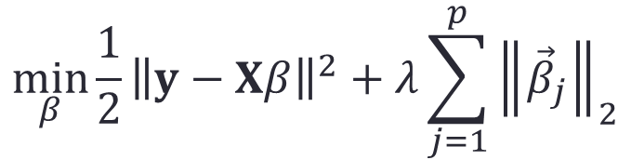
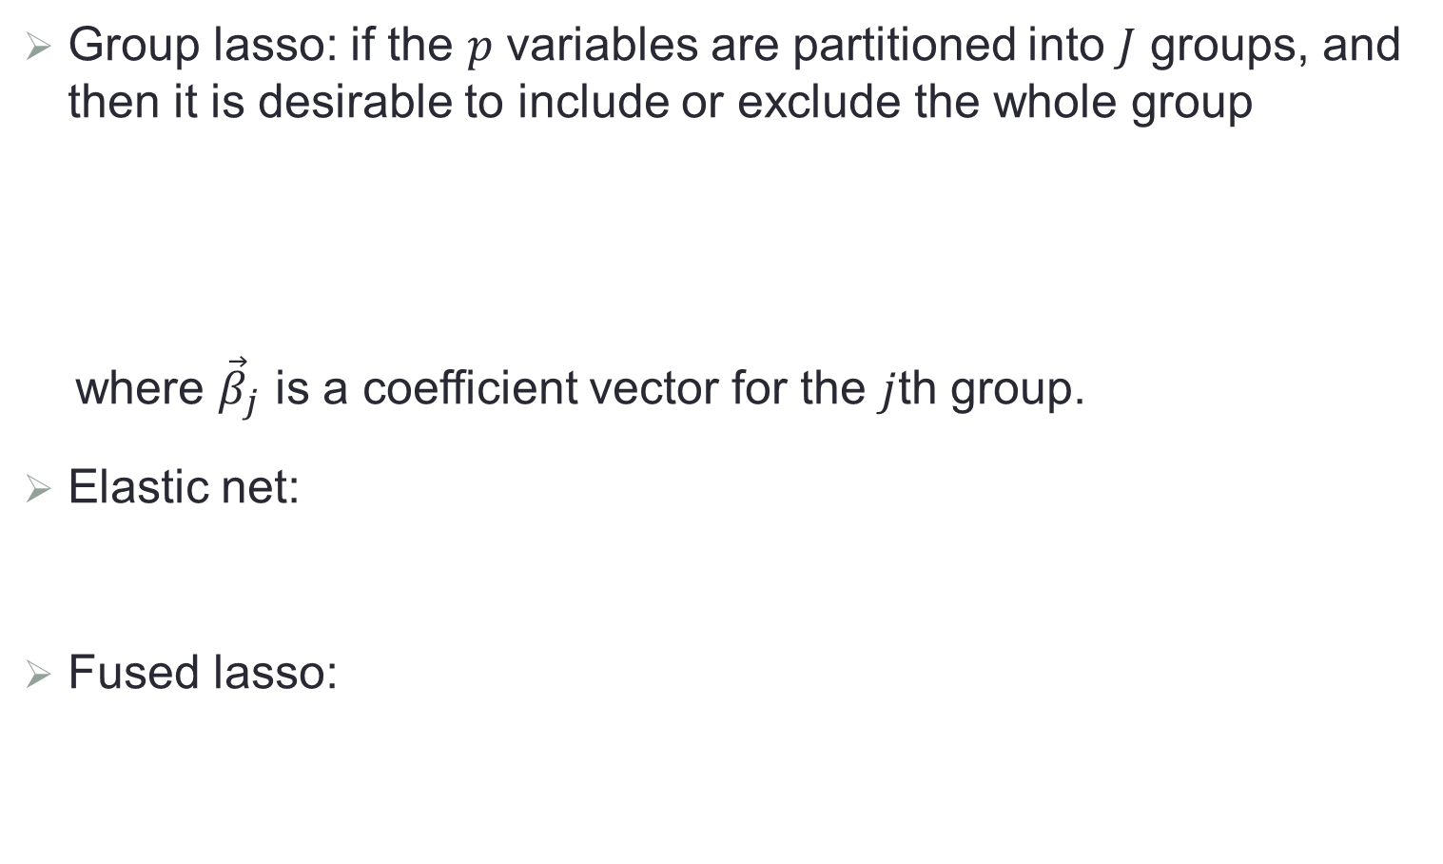
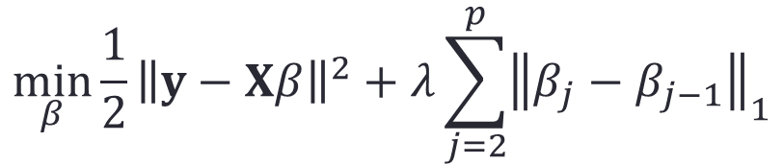
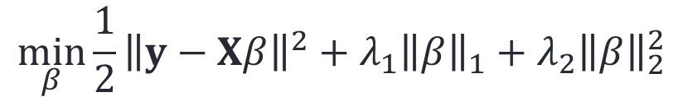
Other Extensions
Group lasso: if the $p$ variables are partitioned into $J$ groups, and then it is desirable to include or exclude the whole group
where ${\vec{β}}_{j}$ is a coefficient vector for the $j$th group.
Elastic net:
Fused lasso:
$$\min_{β}{\frac{1}{2}{\left\|y−Xβ\right\|}^{2}+λ\sum_{j=1}^{p}{{\left\|{\vec{β}}_{j}\right\|}_{2}}}$$
$$\min_{β}{\frac{1}{2}{\left\|y−Xβ\right\|}^{2}+λ_{1}{\left\|β\right\|}_{1}+λ_{2}{\left\|β\right\|}_{2}^{2}}$$
$$\min_{β}{\frac{1}{2}{\left\|y−Xβ\right\|}^{2}+λ\sum_{j=2}^{p}{{\left\|β_{j}−β_{j−1}\right\|}_{1}}}$$

Slide 26
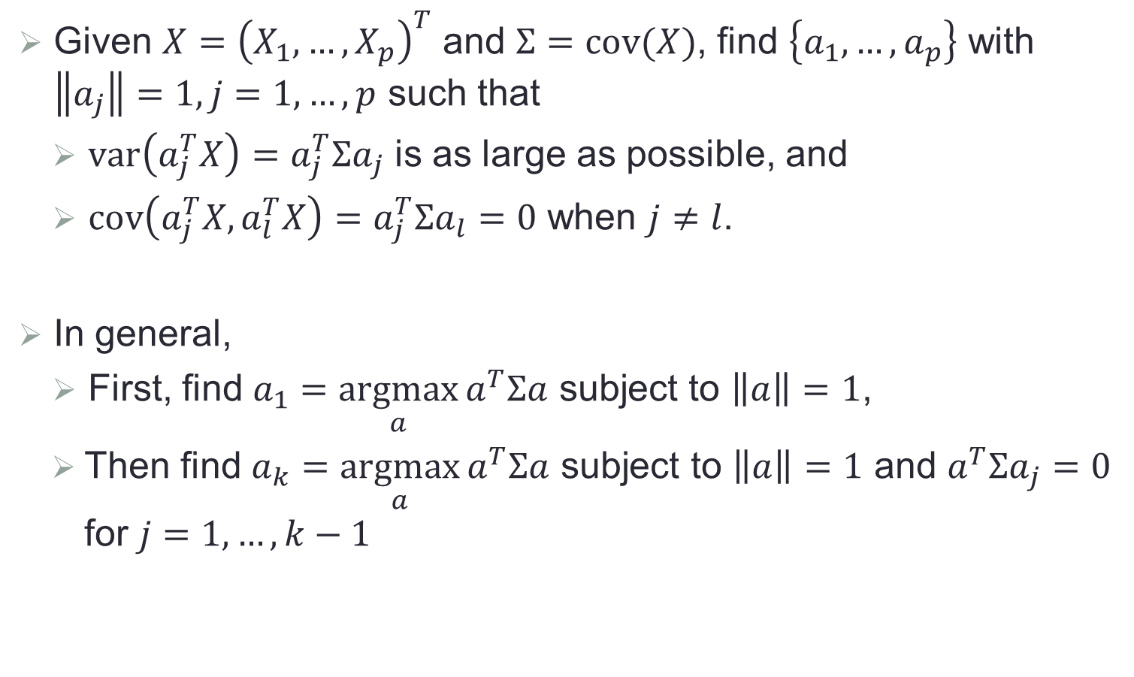
Principal Component Analysis (PCA)
Given $X={\left(X_{1},…,X_{p}\right)}^{T}$ and $Σ=cov(X)$, find $\left\{a_{1},…,a_{p}\right\}$ with $\left\|a_{j}\right\|=1, j=1,…,p$ such that
$var\left(a_{j}^{T}X\right)=a_{j}^{T}Σa_{j}$ is as large as possible, and
$cov\left(a_{j}^{T}X,a_{l}^{T}X\right)=a_{j}^{T}Σa_{l}=0$ when $j≠l$.
In general,
First, find $a_{1}=\underset{a}{argmax}{a^{T}Σa}$ subject to $\left\|a\right\|=1$,
Then find $a_{k}=\underset{a}{argmax}{a^{T}Σa}$ subject to $\left\|a\right\|=1$ and $a^{T}Σa_{j}=0$ for $j=1,…,k−1$

Slide 27
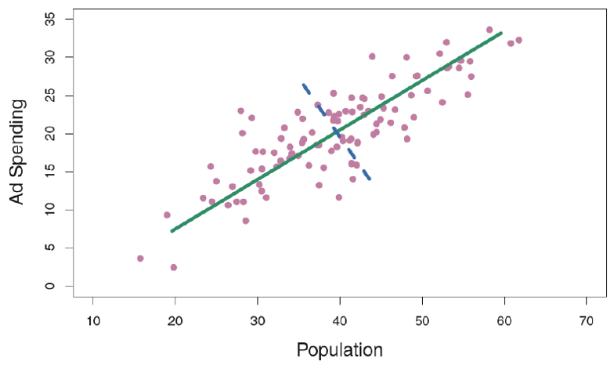
Example

Slide 28
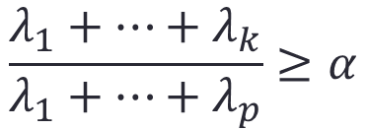
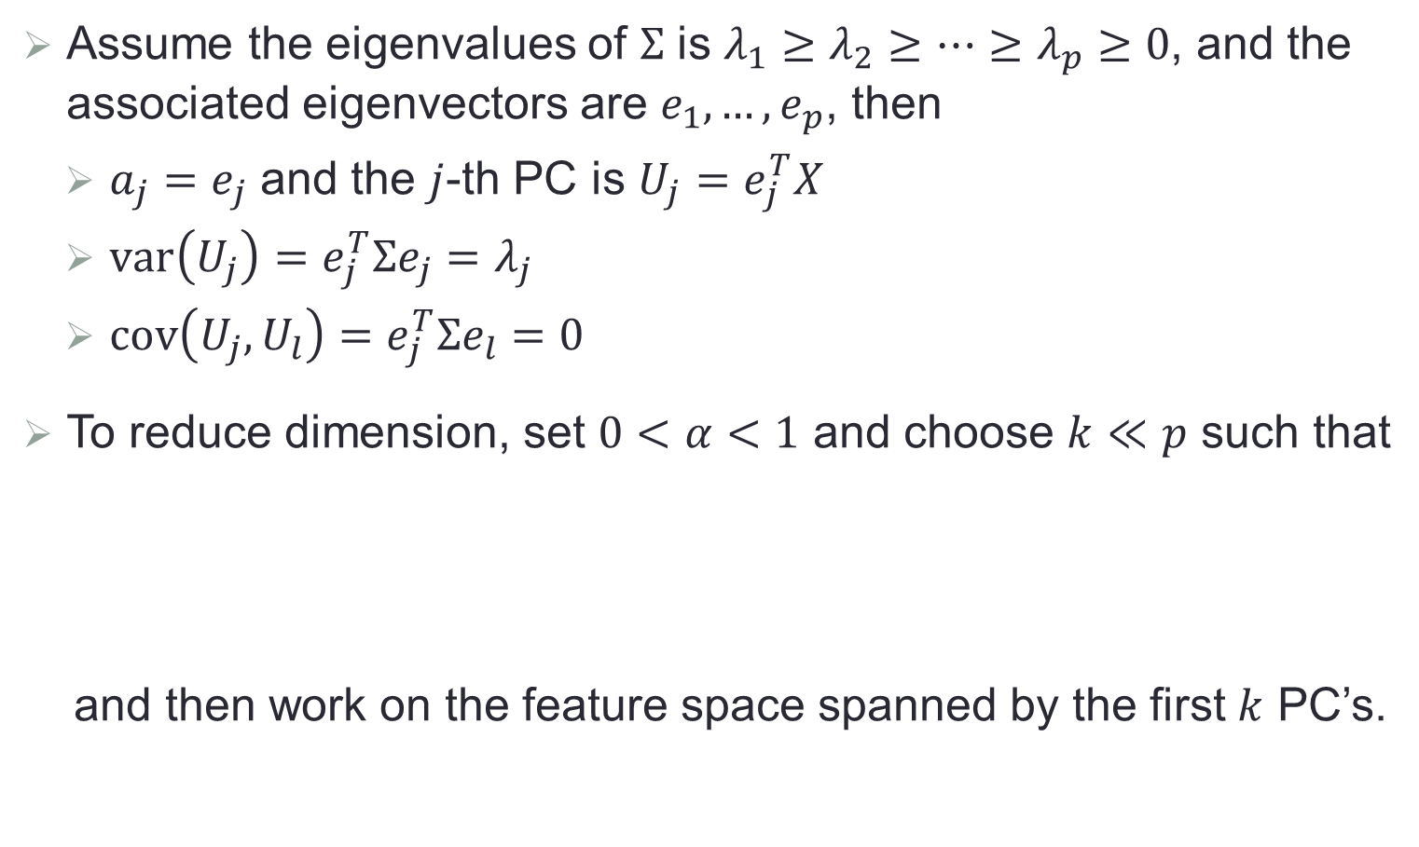
PCA and Eigen-decomposition
Assume the eigenvalues of $Σ$ is $λ_{1}≥λ_{2}≥…≥λ_{p}≥0$, and the associated eigenvectors are $e_{1},…,e_{p}$, then
$a_{j}=e_{j}$ and the $j$-th PC is $U_{j}=e_{j}^{T}X$
$var\left(U_{j}\right)=e_{j}^{T}Σe_{j}=λ_{j}$
$cov\left(U_{j},U_{l}\right)=e_{j}^{T}Σe_{l}=0$
To reduce dimension, set $0<α<1$ and choose $k≪p$ such that
and then work on the feature space spanned by the first $k$ PC’s.
$$\frac{λ_{1}+…+λ_{k}}{λ_{1}+…+λ_{p}}≥α$$

Slide 29
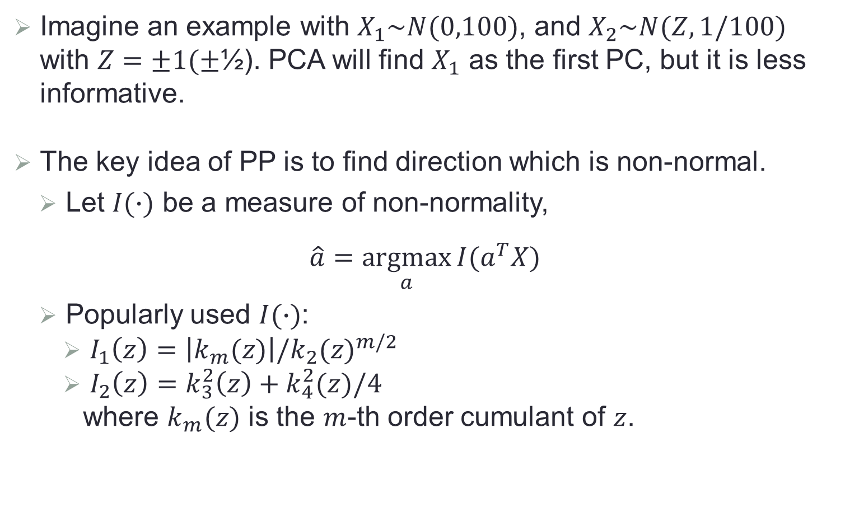
Projection Pursuit (PP)
Imagine an example with $X_{1}\sim N(0,100)$, and $X_{2}\sim N(Z,1/100)$ with $Z=±1(±$½). PCA will find $X_{1}$ as the first PC, but it is less informative.
The key idea of PP is to find direction which is non-normal.
Let $I(∙)$ be a measure of non-normality,
$$\hat{a}=\underset{a}{argmax}{I(a^{T}X)}$$
Popularly used $I(∙)$:
$I_{1}\left(z\right)=\left|k_{m}(z)\right|/{k_{2}(z)}^{m/2}$
$I_{2}\left(z\right)=k_{3}^{2}\left(z\right)+k_{4}^{2}(z)/4$
where $k_{m}(z)$ is the $m$-th order cumulant of $z$.

Slide 30
Projection Pursuit (PP)

Slide 31
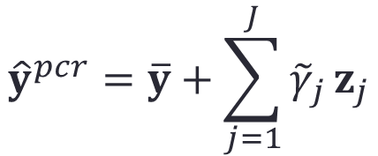
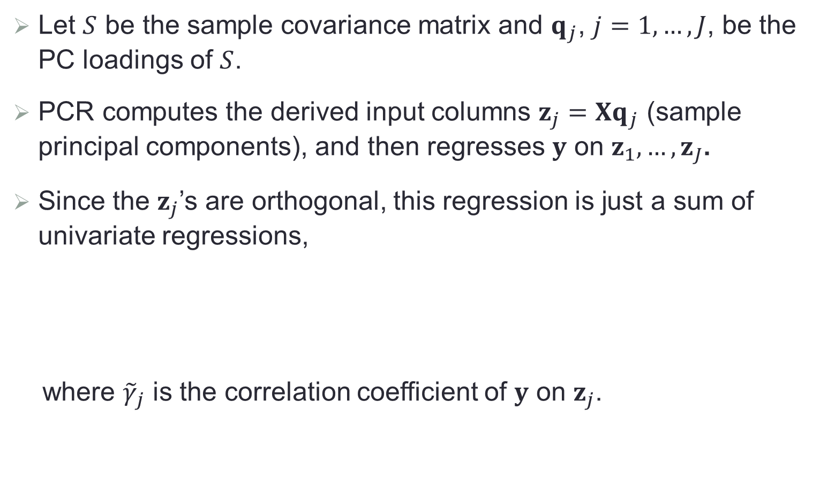
Principal Component Regression (PCR)
Let $S$ be the sample covariance matrix and $q_{j}$, $j=1,…,J$, be the PC loadings of $S$.
PCR computes the derived input columns $z_{j}={Xq}_{j}$ (sample principal components), and then regresses $y$ on $z_{1},…,z_{J}$.
Since the $z_{j}$’s are orthogonal, this regression is just a sum of univariate regressions,
where ${\tilde{γ}}_{j}$ is the correlation coefficient of $y$ on $z_{j}$.
$${\hat{y}}^{pcr}=\overline{y}+\sum_{j=1}^{J}{{\tilde{γ}}_{j}}z_{j}$$

Slide 32
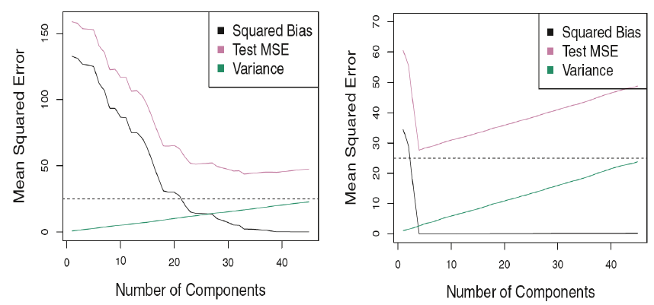
Some Simulated Examples with PCR

Slide 33
Some Remarks on PCR
PCR works well when the first few principal components are sufficient to capture most of the variation in the predictors and the relationship with the response.
PCR does not produce variable selection, as all predictors are included in each principal component.
The number of principal components is typically chosen by cross-validation.
When performing PCR, it is generally recommended to first standardize each predictor.

Slide 34
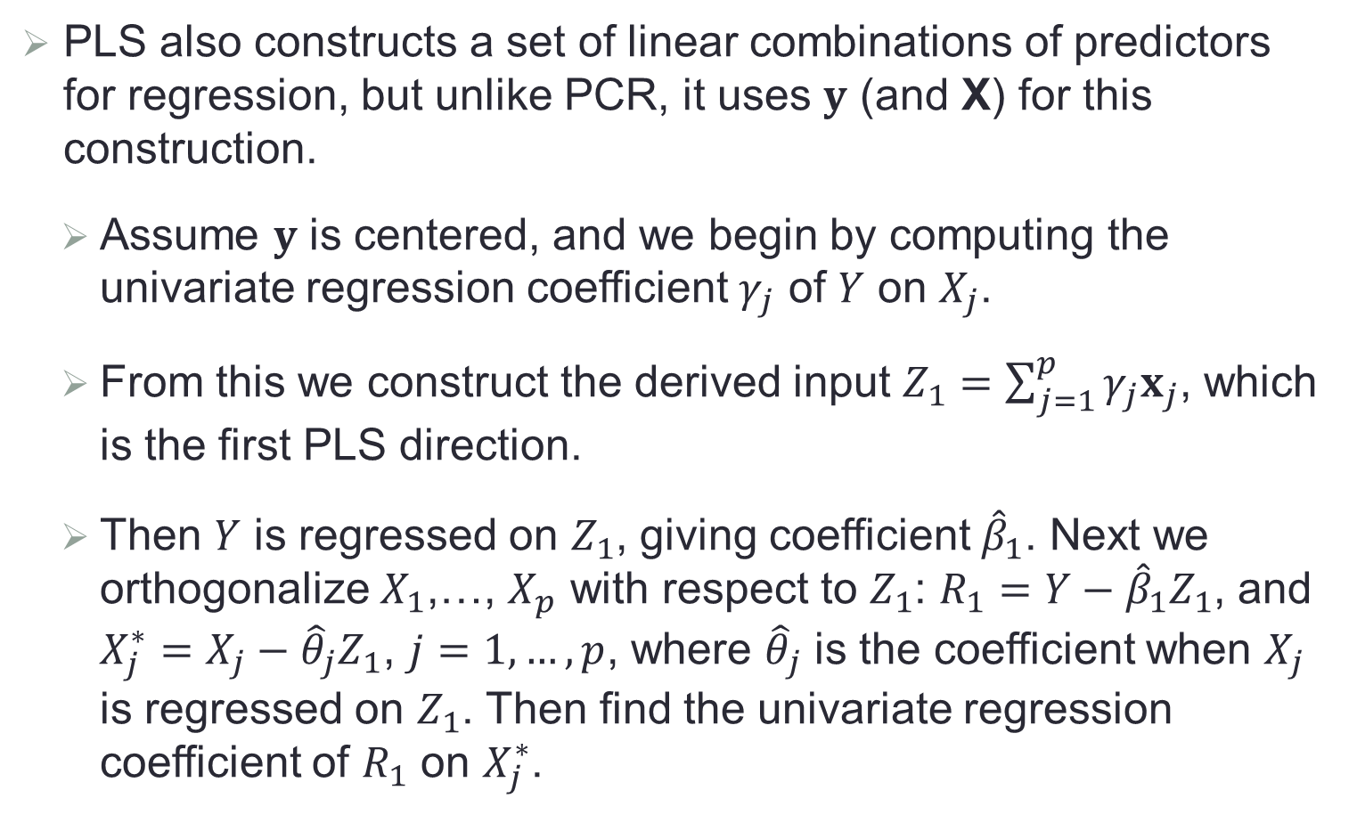
Partial Least Squares (PLS)
PLS also constructs a set of linear combinations of predictors for regression, but unlike PCR, it uses $y$ (and X) for this construction.
Assume $y$ is centered, and we begin by computing the univariate regression coefficient $γ_{j}$ of $Y$ on $X_{j}$.
From this we construct the derived input $Z_{1}=\sum_{j=1}^{p}{γ_{j}x_{j}}$, which is the first PLS direction.
Then $Y$ is regressed on $Z_{1}$, giving coefficient ${\hat{β}}_{1}$. Next we orthogonalize $X_{1}$,…, $X_{p}$ with respect to $Z_{1}$: $R_{1}=Y−{\hat{β}}_{1}Z_{1}$, and $X_{j}^{∗}=X_{j}−{\hat{θ}}_{j}Z_{1}$, $j=1,…,p$, where ${\hat{θ}}_{j}$ is the coefficient when $X_{j}$ is regressed on $Z_{1}$. Then find the univariate regression coefficient of $R_{1}$ on $X_{j}^{∗}$.

Slide 35
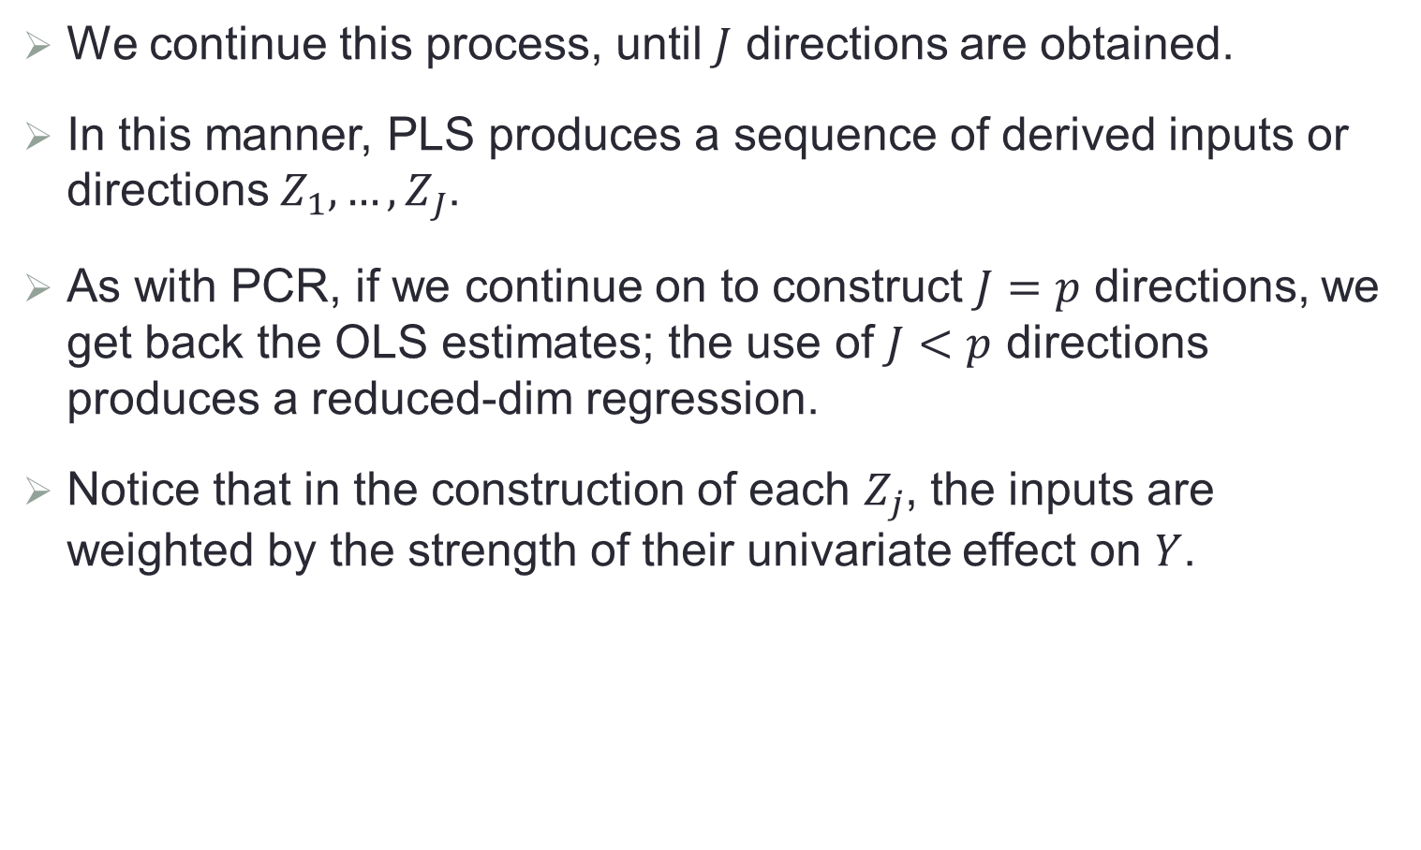
Partial Least Squares (Cont.)
We continue this process, until $J$ directions are obtained.
In this manner, PLS produces a sequence of derived inputs or directions $Z_{1},…,Z_{J}$.
As with PCR, if we continue on to construct $J=p$ directions, we get back the OLS estimates; the use of $J<p$ directions produces a reduced-dim regression.
Notice that in the construction of each $Z_{j}$, the inputs are weighted by the strength of their univariate effect on $Y$.

Slide 36
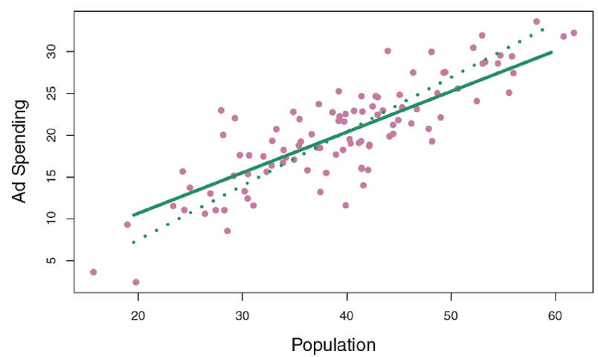
PCR vs PLS
1st PLS direction
1st PC direction

